Slide 1
dewproject.eu
Financial Literacy
Partner: IHF asbl – Institut de Haute Formation aux Politique Communautaires

Slide 2
Objectives & Goals
At the end of this module you will be able to:
Lay the first financial foundations for the creation of a new business or development of an existing one
Be discretionary in the choice of financing tools, methods and timing
Recognize external risk factors and have an example of how to deal with them
Advanced level of the EntreComp competence
FINANCIAL & ECONOMIC LITERACY
Learners can make a plan for the financial sustainability of a value creating activity

Slide 3
Index
Unit 1: Cost of financing and interest rates
Section 1: Financing cost
Section 2: Interest and interest rate
Section 3: Different types of rates
Unit 2: Debt VS Equity financing
Section 1: Overview
Section 2: Debt financing: loans and borrowing
Section 3: Equity financing – best practice
Unit 3: Inflation
Section 1: Overview
Section 2: Inflation dashboard
Section 3: Why it matters
Section 4: How to manage it – best practice

Slide 4
1. Cost of financing and interest rates
Section 1: Financing cost
An enterprise funds its operations using two different sources:
EQUITY FINANCING DEBT FINANCING
Capital gains and dividends are required by equity investors, while debt providers seek interest payments.
Financing cost (FC), however, refer to the interest and other fees charged to debt financiers. Interest expense can be incurred on both short-term (less than an year) and long-term financing.
The cost, interest, and other charges associated with an enterprise’s money require to create, purchase assets, or carry out operations – setting up or developing a business – are referred to as financing cost.

Slide 5
1. Cost of financing and interest rates
Section 2: Interest and interest rate
The enterprises and the investors in general use the following formula to calculate financing cost:
(Total amount paid back – Total amount borrowed) Simple Interest
Interest cost = =
Total amount borrowed Principle amount
In order to better understand the concept of interest and thus financing cost, reference must be made to the interest rate by introducing the concept of time, i.e. the time required to repay the financing.
Interest cost 🡪 annualized and compounded 🡪 Interest Rate
P = Principle amount = Total amount borrowed
SI = Simple Interest = Total amount paid back – P
t = number periods for a year
r = interest rate
Example 1:
P = 1000
Total amount paid back = 1400
SI = 1400 – 1000 = 400
t = t₀ – t₁ = 24/12 = 2
€1000
r = ?
€1400
t₀
t₁ = 24 months
r = (400 x 100) / (1000 x 2) = 20%
r =
(SI x 100)
20% is the interest rate – i.e. the portion of the financing that is charged as interest to an enterprise, expressed as an annual percentage of the outstanding financing.
(P x t)

Slide 6
1. Cost of financing and interest rates
Section 2: Interest and interest rate
Compound Interest (CI), also called interest on interest, is another method to calculate financing cost. It is applied to both the capital – principle – and the accumulated interest earned in prior periods.
At the end of the first year the enterprise owes the principle amount's portion plus interest for that year. At the end of the second year, the enterprise owes the principal's portion plus the interest for the that year plus the interest on interest for the previous year. And so on.
So, when compounding, the interest owed is greater than the interest owed when utilizing the simple interest approach.
🡪 CI > SI
CI = P x (1 + r)^{t} – P
P = 1000
SI = 400
t = 2
r = 20%
CI = 1000 x (1 + 0,20)² – 1000 = 440
Example 1:
440 > 400 🡪 CI > SI
For shorter time periods, the interest calculation will be similar for both methods – SI and CI. However, as the financing period lengthens, the discrepancy between the two forms of interest estimates rises, pending in favour of CI versus SI.

Slide 7
1. Cost of financing and interest rates
Section 3: Different types of rates
APR vs APY
Annual Percentage Rate (APR)
APR is the annual rate of interest without taking into account the compounding of interest within that year.
APR = Periodic Rate x Number of Periods in a Year
Annual Percentage Yield (APY)
APY does take into account the effects of intra-year compounding.
APY = (1 + Periodic Rate)^{Number of periods} – 1
Example 2: A credit card company might charge 1,5% interest
APR = (1,5% x 12 months) = 18%
APY = (1 + 0,015)¹² – 1 = 19,56%
You will be charged the comparable yearly rate of 18% if you just hold a debt on your credit card for one month. However, if you hold that sum for the entire year, your effective interest rate rises to 19,56% due to monthly compounding.
Online APR 🡪 APY calculator:
https://www.aprtoapy.com/

Slide 8
2. Debt VS Equity financing
Section 1: Overview
DEBT FINANCING
EQUITY FINANCING
Borrowing of the money
Additional financial load on the enterprise
Obligation to pay the money obtained back with interest
Easy forecast costs
Repayment schedule
Sale of a portion of enterprise’s equity
Management business sharing
Profit-sharing
Easier access to the nascent stage
The debt-to-equity ratio (D/E) indicates how much of an enterprise’s financing is provided by debt and equity in proportion.
Total Debts
D/E =
Generally, 0,5 < D/E < 1,5 is considered good in terms of enterprise’s risk.
Total Shareholders’ Equity

Slide 9
2. Debt VS Equity financing
Section 2: Debt financing: loans and borrowing
LENDER
A lender is an individual, a group, or a financial institution who loans money with the expectation of repayment, typically with interest
BORROWER
A borrower is an individual or entity – enterprise – who obtains money on credit, i.e. with the intention of returning it, typically with interest
Loans are generally given by banks or private lenders and they are regulated through a formal loan agreement.
Regardless of who makes the loan, the borrower is required to repay it, with interest and within a set time frame. If the borrower fail to repay, the lender may have the right to take the borrower’s asset if collateral is provided – something used as security, in case the loan is not repaid.
Soft Loan: It is given with next-to-no or no interest with extended grace periods, that is more lenient than standard loans.
Tip: Grants are, in essence, gifts. Non-repayable. Grants can be given to individuals, businesses, educational institutions, or no-profits by government departments, trusts, or corporations. There are several parameters to access them.
An enterprise must be incorporated before a loan can be applied for

Slide 10
2. Debt VS Equity financing
Section 3: Equity financing – best practice
The scale and scope of equity financing include a wide range of activities, from raising a few hundred dollars from friends and family to raising billions of dollars from huge organizations and a large number of investors in Initial Public Offerings.
Among the most common and well-know kinds outside equity funding are:
Angel Investors: They are someone or groups – generally friends, family or professional investors – who invest their own money in a business. They have no claim on the day-to-day business management.
Venture Capitalists (VC): They are professional and skilled investors who provide capital to selected enterprises. They can invest other people’s money.
Initial Public Offering (IPO): An enterprise can source funds by offering and selling the shares to the public in a new stock issuance. From private ownership to public ownership.
Crowdfunding: The method of funding a project or enterprise by raising money from a large number of people/investors who provide for a small account – as small as €1000 for each investor. It typically starts with an online “campaign” via one of the crowdfunding sites.

Slide 11
2. Debt VS Equity financing
Section 3: Equity financing – best practice
Best practice: Women TechEU – Supporting deep-tech start-ups led by women
Funded under the programme Horizon Europe, Women TechEU is a new initiative of the European Union. The scheme offers first-class coaching and mentoring to female founders, as well as targeted funding to help take their business to the next level. This initiative offers among other things:
Financial support to the company as an individual grant of EUR 75,000 to support the initial steps in the innovation process, and the growth of the company,
The possibility to participate in dedicated activities organised by InvestEU and Enterprise Europe Network

Slide 12
3. Inflation
Section 1: Overview
Quantities bought in the base year | Price (base year) |  | Price (1 year later) |  | Price (2 years later)
 | per unit | total | per unit | total | per unit | total
150 loaves of bread | €1.50 | €225 | €1.30 | €195 | €1.60 | €240
100 cups of coffee | €2.40 | €240 | €2.40 | €240 | €2.15 | €215
12 haircuts | €20.00 | €240 | €22.00 | €264 | €23.00 | €276
1 winter jacket | €145.00 | €145 | €176.00 | €176 | €160.00 | €160
Total cost of basket |  | €850 |  | €875 |  | €891
Price index |  | 100.0 |  | 102.9 |  | 104.8
Inflation rate |  |  |  | 2.9% |  | 1.8%
What is inflation? Broad increase in prices
«In a market economy, prices for goods and services can always change. Some prices rise; some prices fall. Inflation occurs when there is a broad increase in the prices of goods and services, not just of individual items; it means, you can buy less for €1 today than you could yesterday. In other words, inflation reduces the value of the currency over time.
(…)
All the goods and services consumed by households during the year are represented by a “basket” of items. Every product in this basket has a price, which can change over time. The annual rate of inflation is the price of the total basket in a given month compared with its price in the same month one year previously».
Source: European Central Bank

Slide 13
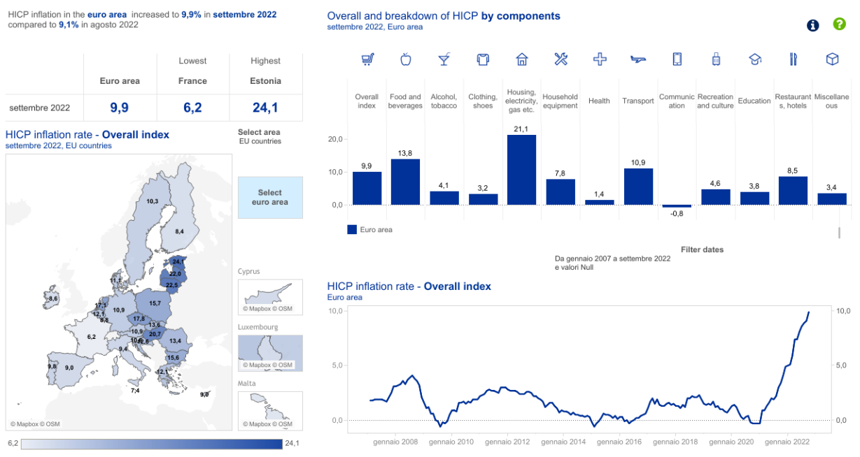
3. Inflation
Section 2: Inflation dashboard
Consumer price inflation in the Euro area is measured by the “Harmonised Index of Consumer Prices” (HICP).
Who calculates the HICP?
Eurostat, the Statistical Office of the European Communities
Last update: 19 October 2022
Next update will be in the afternoon of 17 November 2022
For latest HICP data and future update can be accessed via the link below
Source: www.ecb.europa.eu/inflation/stats

Slide 14
3. Inflation
Section 3: Why it matters
Inflation has a wide-ranging impact on the economy. It affects individual spending power, business investments, interest rates, tax policies, government programs, national debt, and also other aspects.
Why increased inflation matters for a woman digital entrepreneur?
Increased costs in general
Decreased purchasing power
Increased interest rates 🡪 greater financing difficulties
Difficulties in pricing which result in increases – because the inflation is a price lever
Overall macroeconomic uncertainty 🡪 reduction in economic activity 🡪 stunt economic growth

Slide 15
3. Inflation
Section 4: How to manage it – best practice
The main players for addressing inflation are the central banks – the European Central Bank (ECB) in the European case – and central governments, through a number of monetary policy tools.
However, what can an entrepreneur do in her own small way to address inflation in the short term, to ensure business continuing growth and that rising costs do not weigh on prices – increasing them – and thus on the end consumer? So, what can she do to manage the inflation?
Best practice: SHRINKFLATION
Shrinkflation: same price, same packaging, but less product inside. It is a strategy chosen by some enterprise in order not to make consumers perceive the price increase due to inflation and to avoid a decrease in spending and consumption.
Before: 500g 🡪 €2
After: 440g 🡪 €2

Slide 16
Summing up
Financing
Inflation
Access to finance
Financing cost
Interest
Interest rate
Debt financing
Equity financing
Women Tech EU
Increase
Prices
Purchasing power
European Central Bank
Eurostat
HICP
Shrinkflation

Slide 17
Thank you!
dewproject.eu

